Slide 1
AWS Mobile Hub Docs BUILD INTEGRATE CONTENT PUBLISH

Slide 2
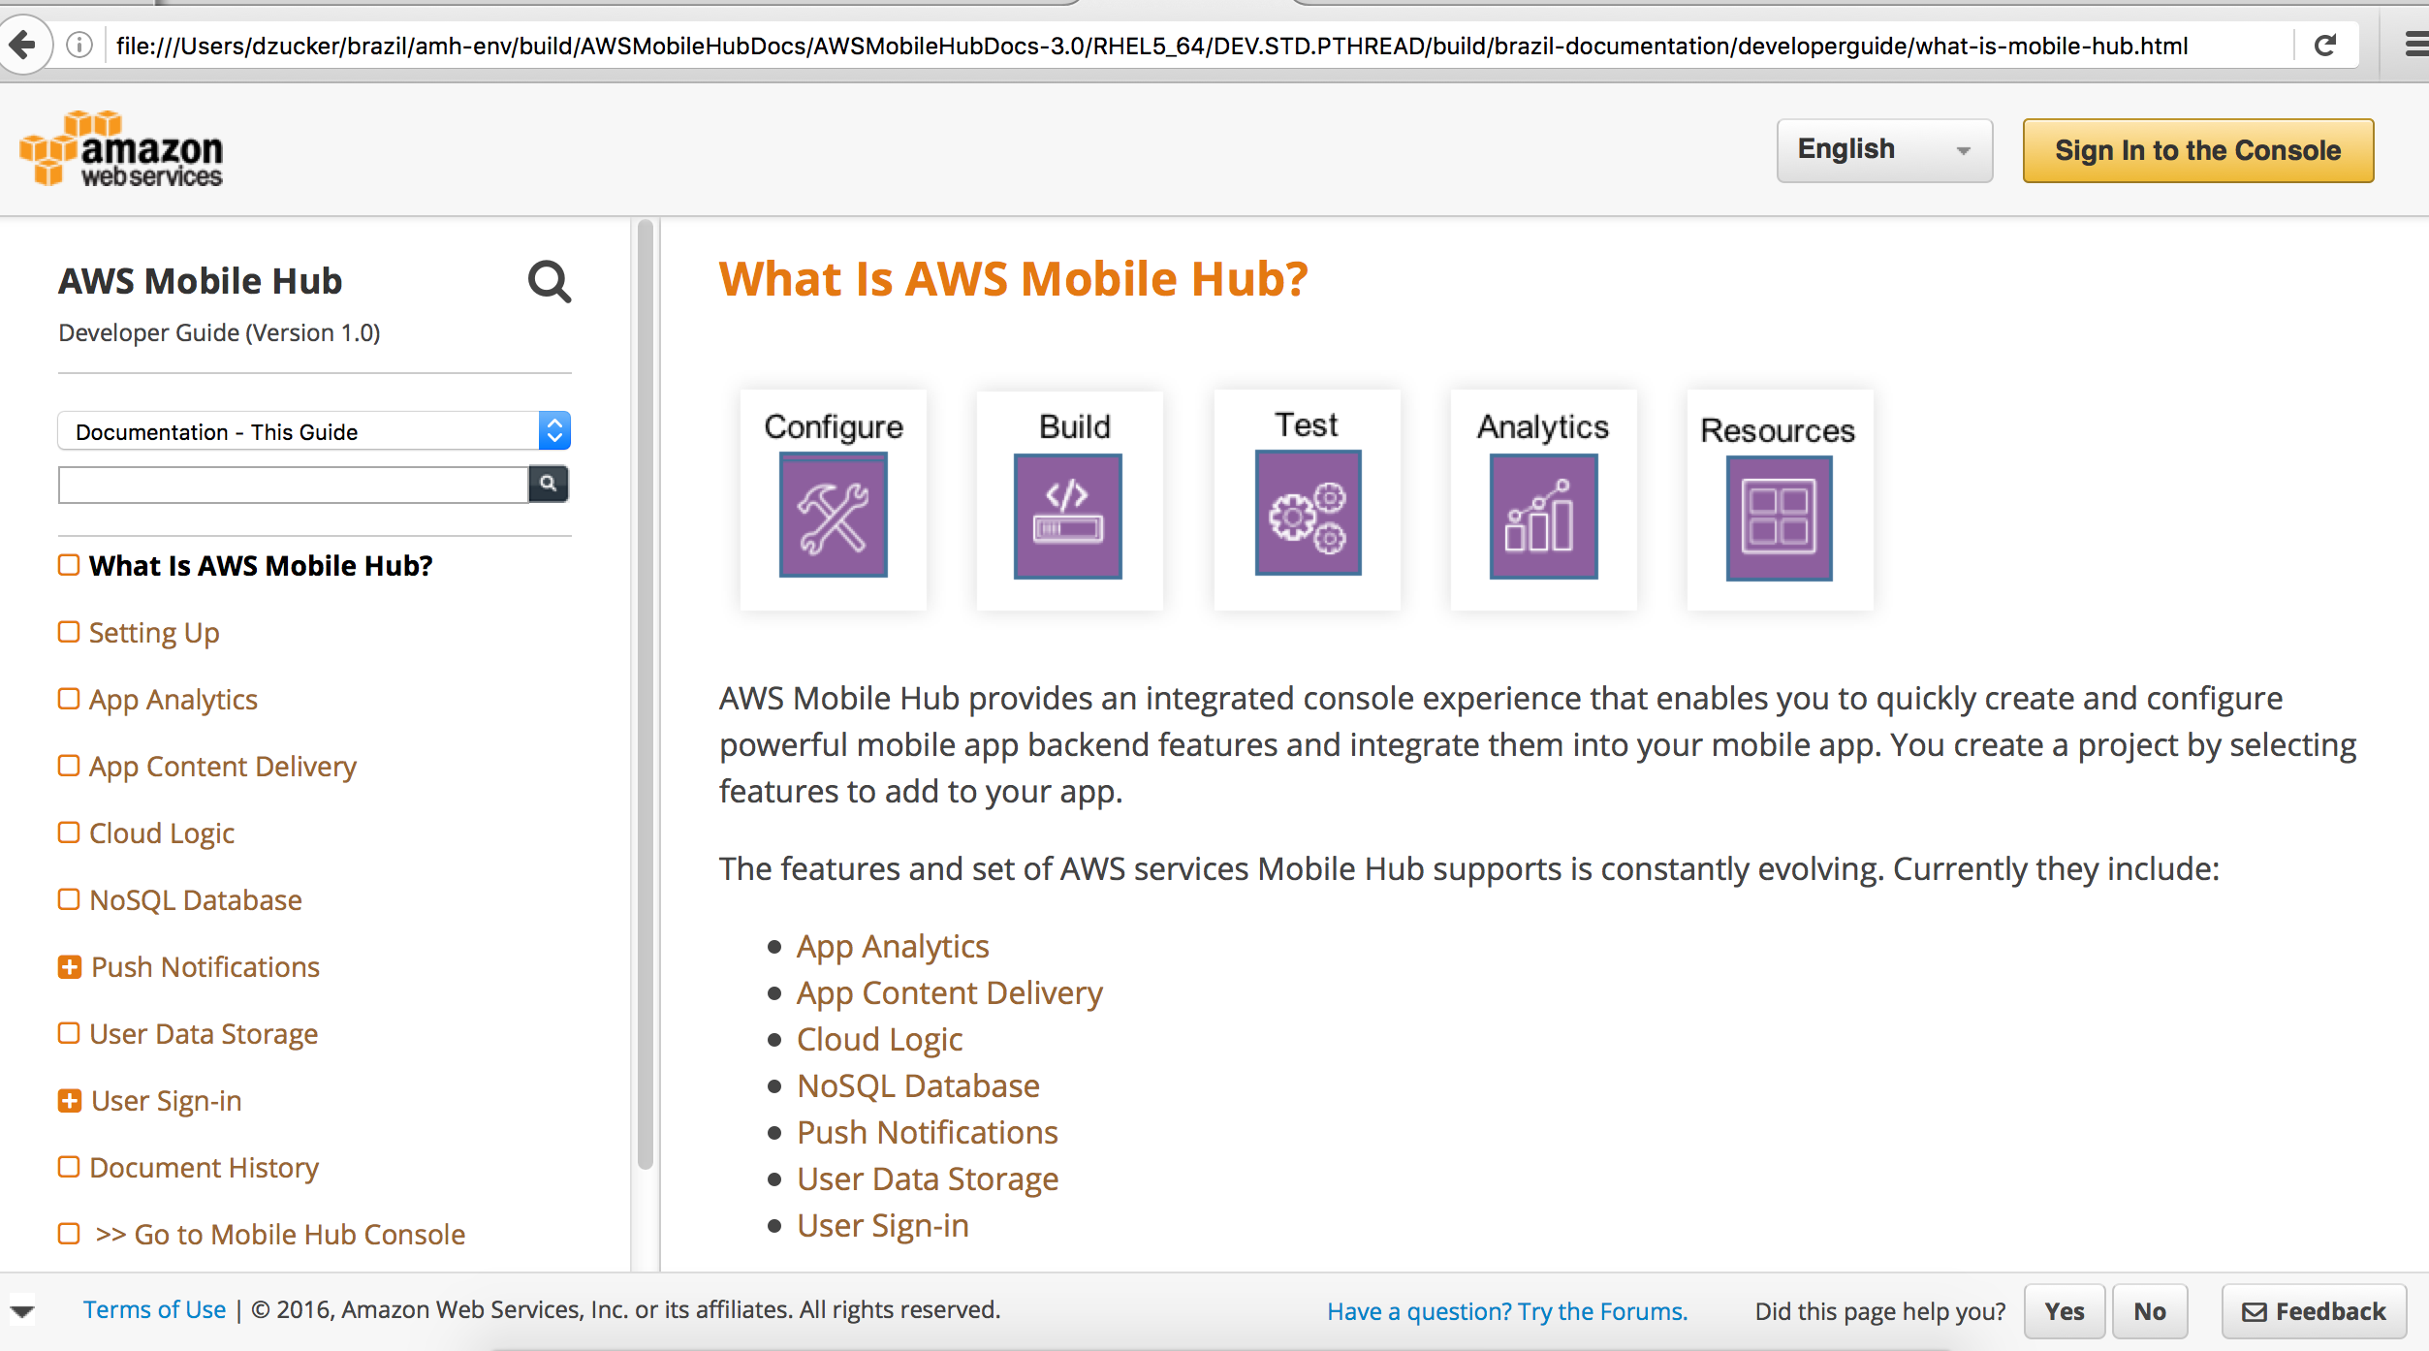
Publish MH Build>Integrate Content External to MH
Downloaded
EverythingApp
Packages
GITHUB
AWSMobileHubIntegration
Repo
Android
MH Build
2
iOS
Swift
iOS
objC
1
7
EDITORIAL PROCESS
iOS ObjC
EDITORIAL PROCESS
iOS ObjC
EDITORIAL PROCESS
iOS Swift
EDITORIAL PROCESS
EDITORIAL PROCESS
iOS Swift
Android
EDITORIAL PROCESS
Android
AppAnalytics
3
EDITORIAL PROCESS
IntegratingMHFeatures.rst
AppContentDelivery
AppAnalytics.rst
CloudLogic
Rationalize content that is MH specific & obscure secrets
AppContentDelivery.rst
MicroServices
CloudLogic.rst
docs.aws.amazon.com
PushNotifications
4
MicroServices.rst
UserDataStorage
Add intro / overview page
PushNotifications.rst
UserSignIn
5
UserDataStorage.rst
EverythingApp integration guidance content for each feature
Convert to RST
UserSignIn.rst
6
8
SPHINX

